Slide 1

Fitness Tracker
Enhancing Exercise Tracking using Predictive Modelling
Presented By: Vedant Patil

Slide 2
Problem Background
Goal
Inaccuracies and inconsistencies in manually logged workout data
Current devices cannot identify specific types of gym workouts
Existing fitness trackers do not provide immediate analysis of exercise performance and form
To develop a Predictive Modeling-Based Tracking System:
To accurately predict Gym exercises
Precisely count the number of repetitions performed
Visualize exercise performance

Slide 3
Project Workflow
Raw Data Collection
1
Data Collection
Data Pre-processing
2
Data cleaning and data consolidation

Slide 4
Feature creation and noise handling
3
Feature Engineering
Parameter Tuning
4
Hyper parameter tuning and feature splitting
Cross validation and model development & selection
5
Predictive Modeling

Slide 5
Peak finding and benchmark validation
6
Reps Counting
Flask Application
7
Backend development
Front end development
8
Interface Development

Slide 6
Dataset Definition
This data in this dataset is collected using the MBientlab’s wrist band sensor. (Source: Kaggle)
Comprises of 5 Exercises
Has 2 Set types: Heavy & medium
Gyroscope Data: Measures angular velocity around three axes
Accelerometer Data: Measures linear acceleration along three axes
Monitors rotation and form during exercises
Tracks movement

Slide 7
Data Pre-Processing
Creating a centralized dataset with outlier null value handling
Consolidation
Merge & Resample
Outlier Removal
Creating 2 data-frames:
One for accelerometer and one for gyroscope data;
along with additional columns for participant, exercise, category and set
Merging data and restructuring the timeseries data segments to a 200ms interval
Testing outlier removal functions (LOF, IQR)
Choosing Chauvenet’s criterion to detect outliers and drop them

Slide 8
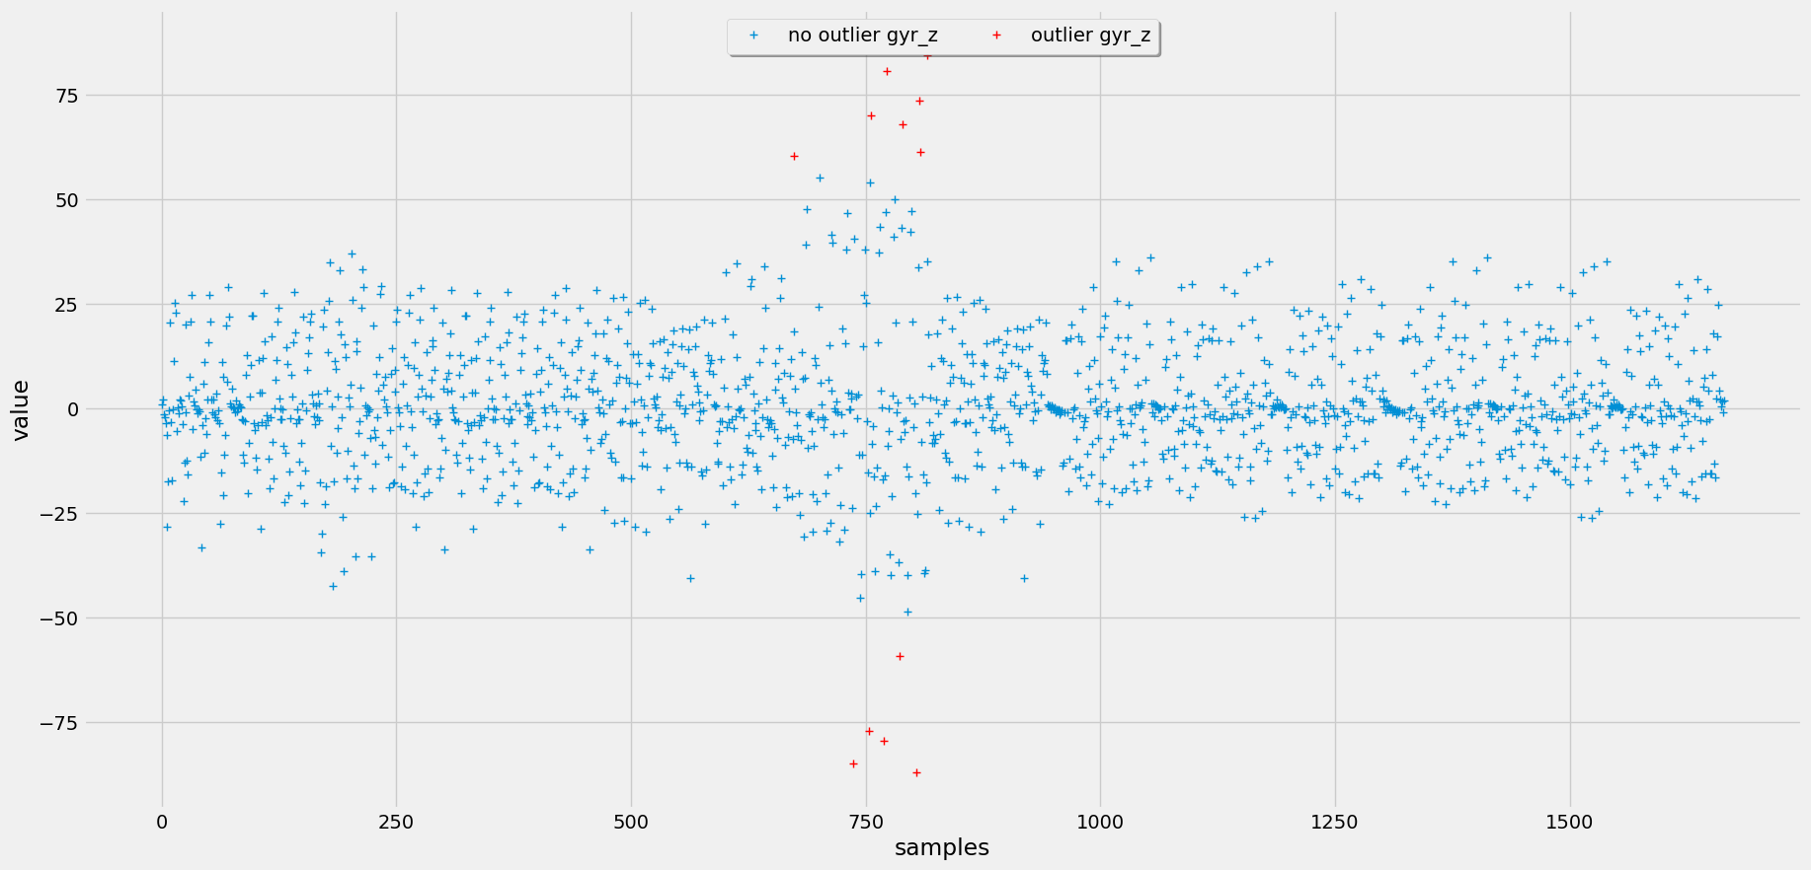
Outliers using Chauvenet’s criterion

Slide 9
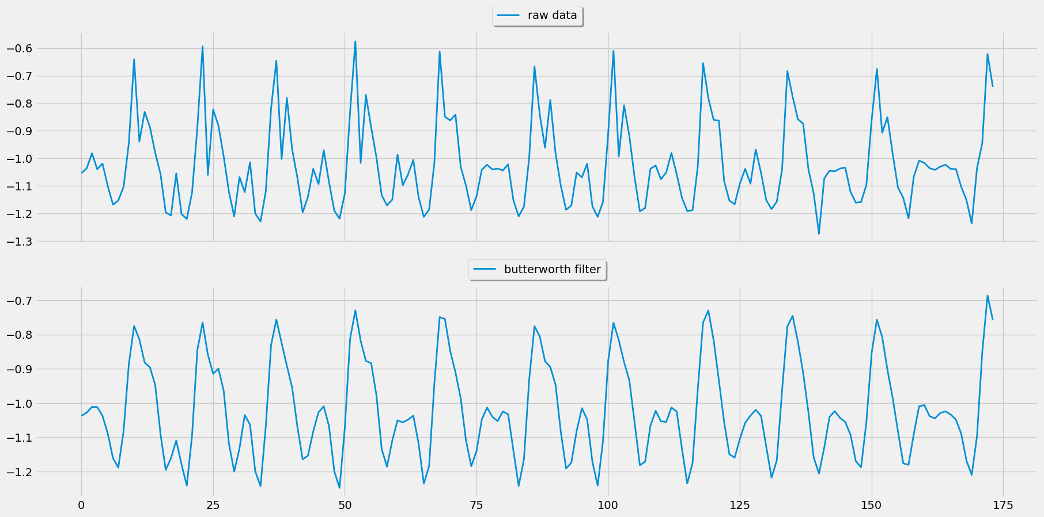
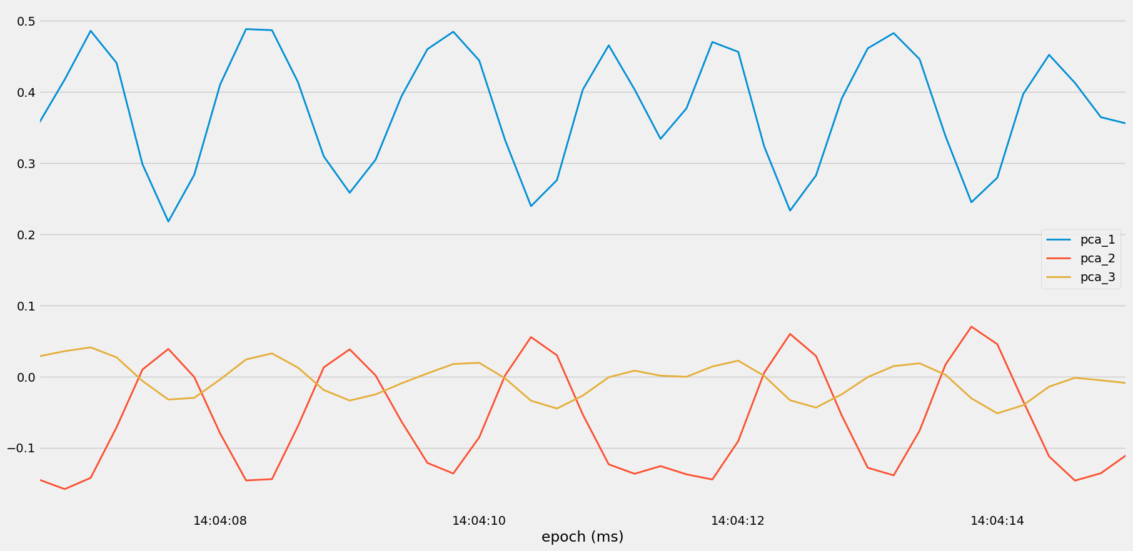
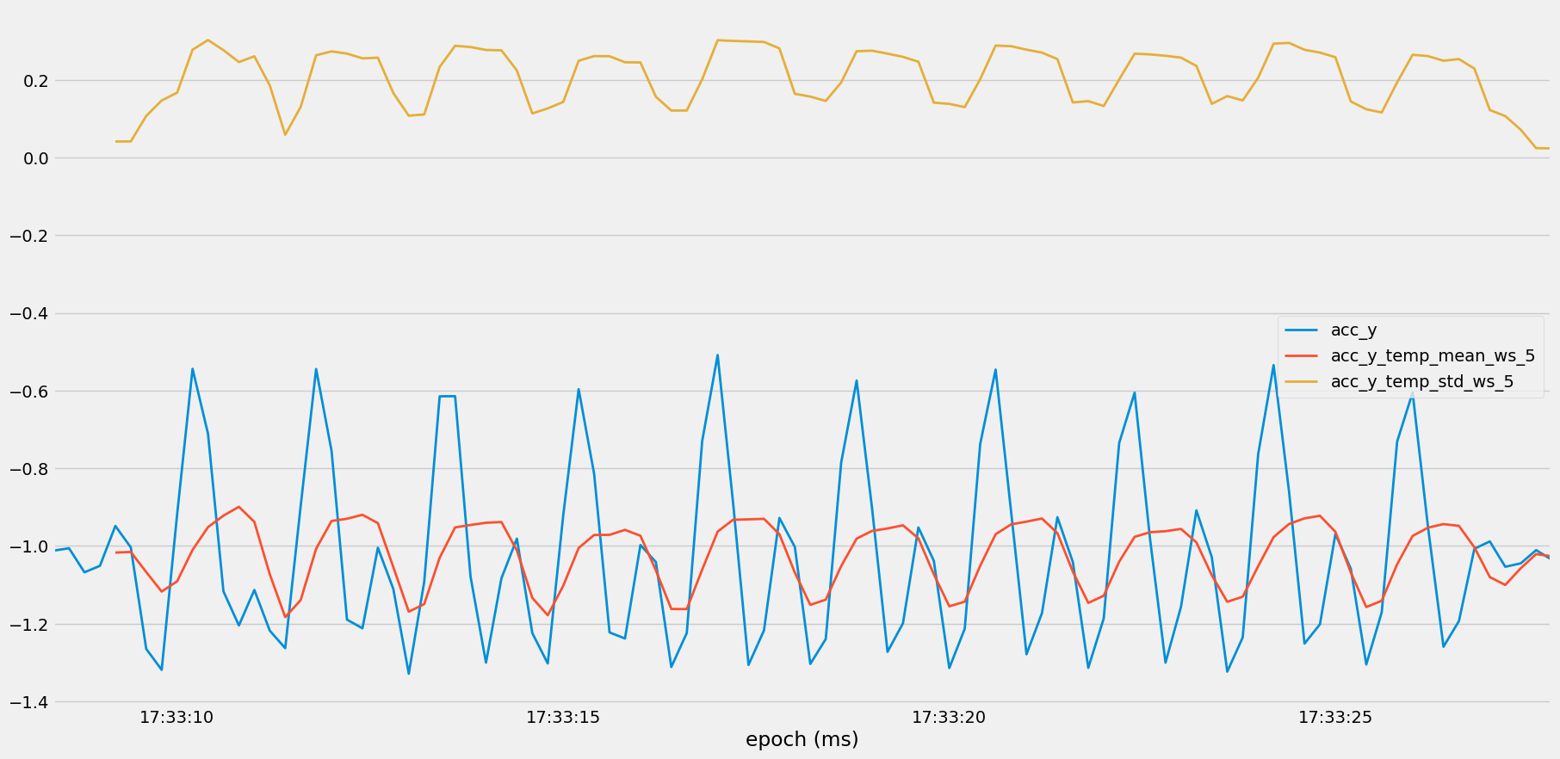
Feature Engineering
Selecting meaningful features to develop & create new features to represent dataset in a more effective way
LowPass
PCA
Temp Abs
Filtering high frequency noise from the data;
Data above a certain threshold will be removed
Calculating the mean and standard deviation for a rolling window size; Summarizing the data
Reducing complexity of the data by introducing Principal Components

Slide 10
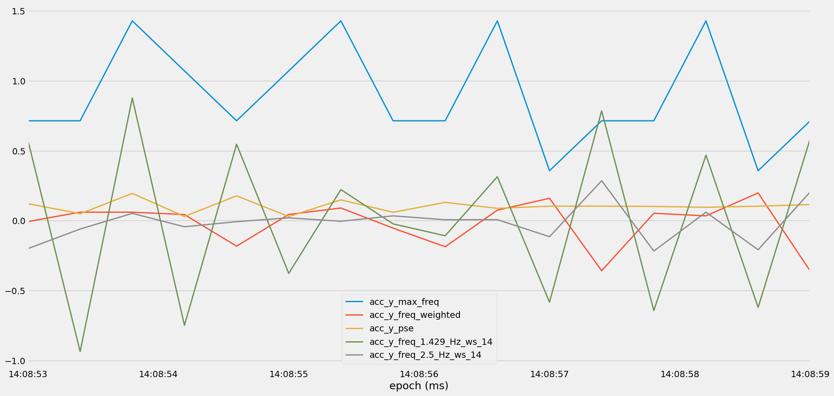
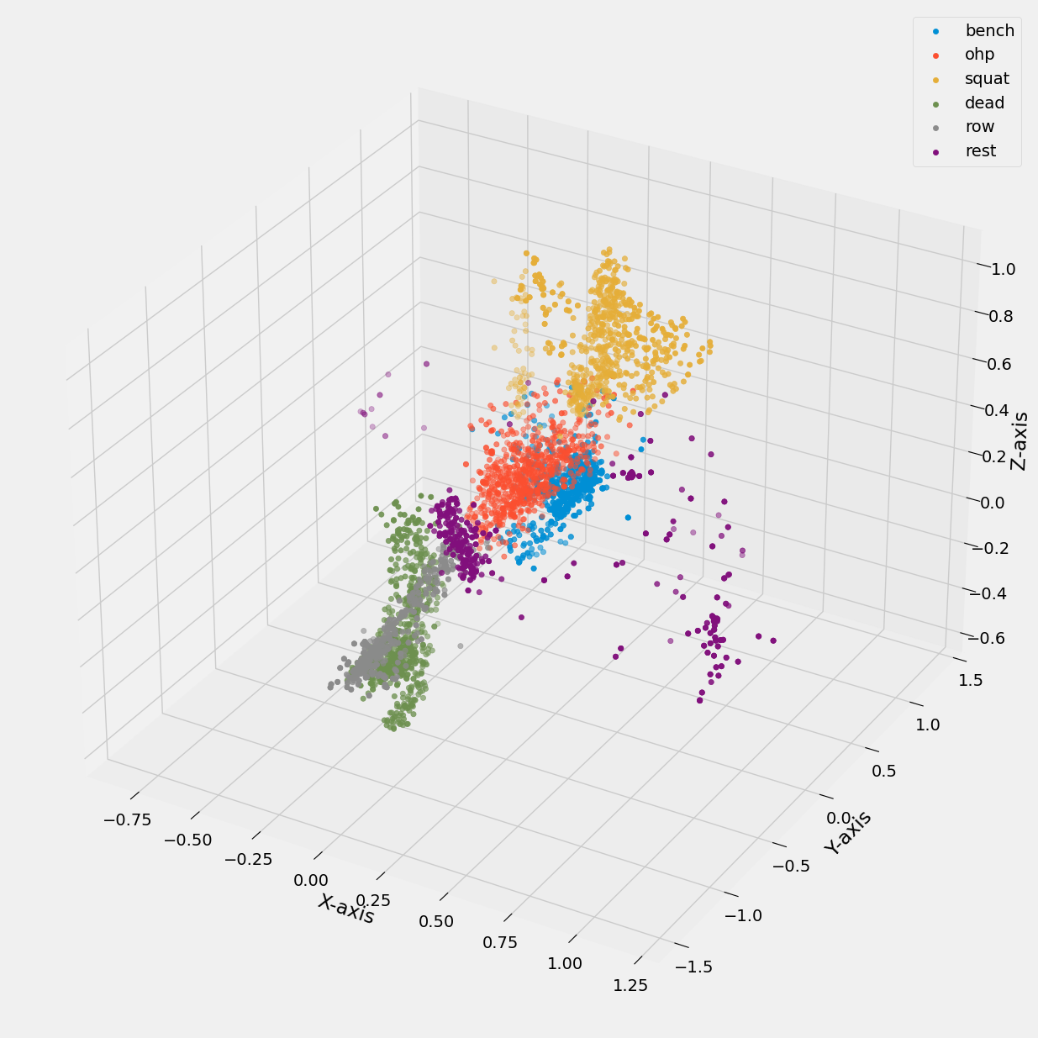
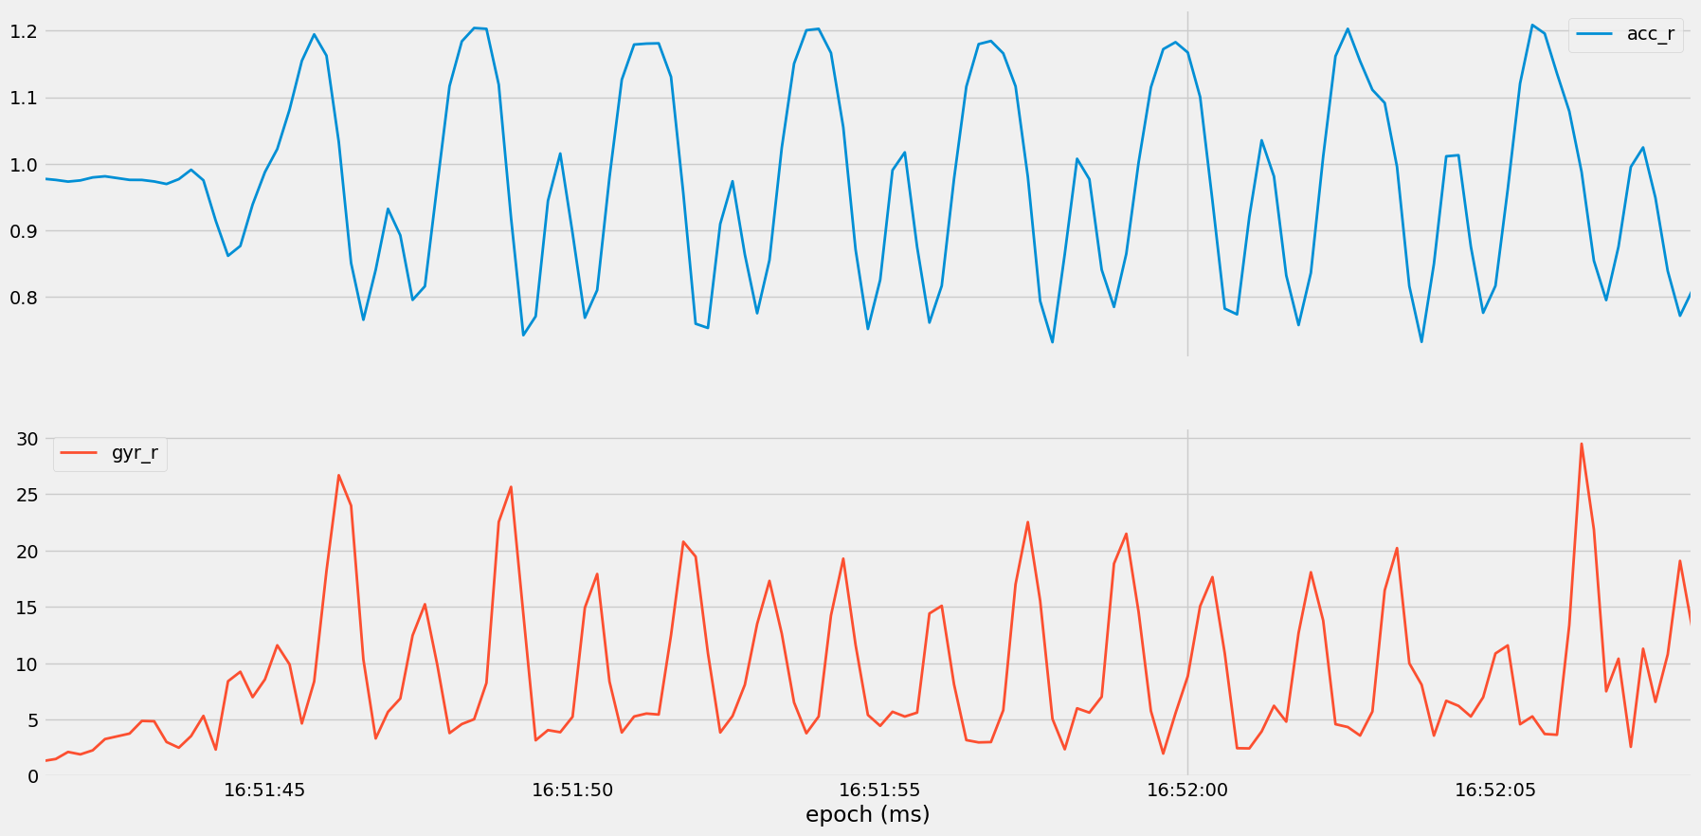
Fourier
Clustering
Sum of squared
Adding frequency features by decomposing the original signal into different frequencies
Using K-means, clustering accelerometer data into 5 different clusters
Calculating the scalar magnitudes of the accelerometer and gyroscope data

Slide 11
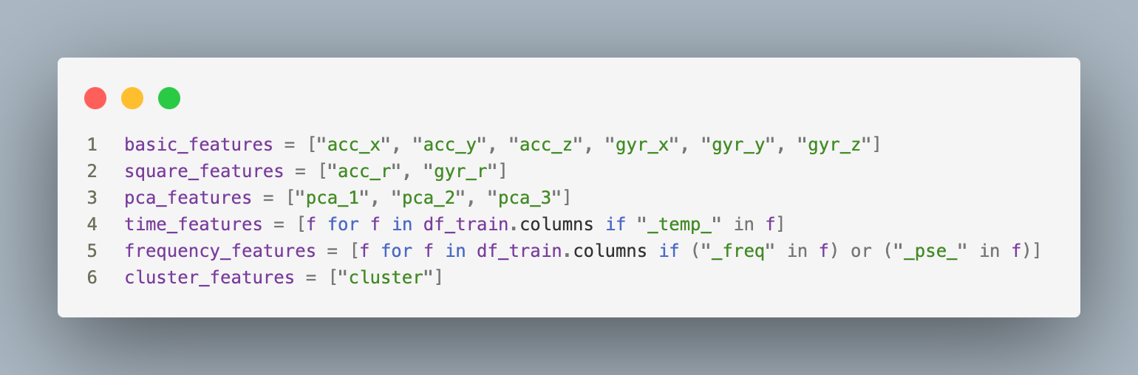
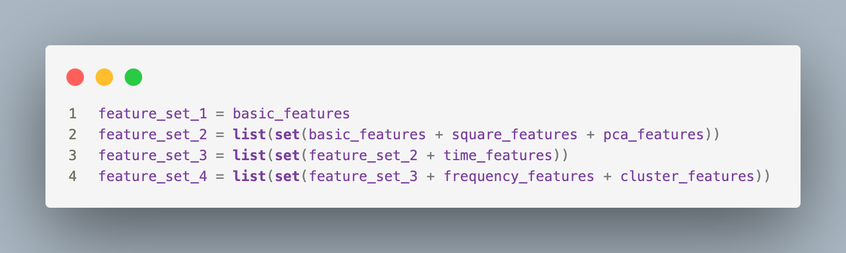
Parameter Tuning
Feed Forward Selection
Feature splitting
Select best performing features
Splitting features into subsets for better cross-validation

Slide 12
Models
Neural Network
Random Forest
Naïve Bayes
96%
97%
90%
Best accuracy attained with feature_set_4 at 99.58%
Best accuracy attained with feature_set_4 at 99.48%
Best accuracy attained with feature_set_4 at 94.93%

Slide 13
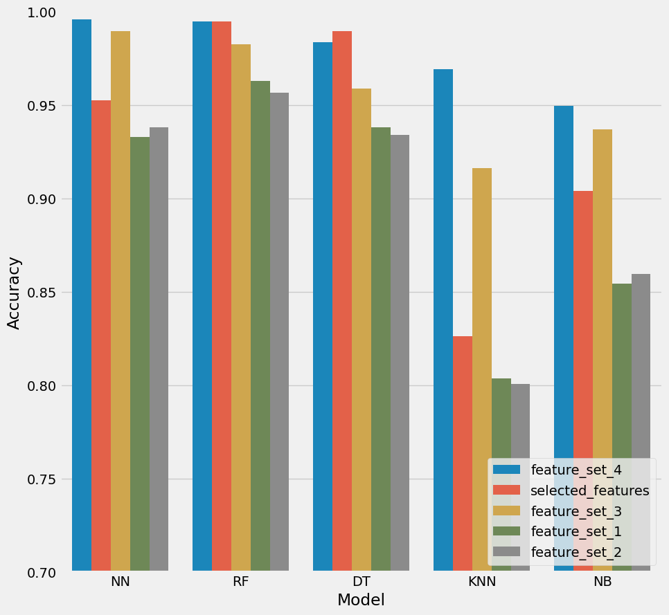
Decision Tree
KNN
Model Comparison
96%
86%
Best accuracy attained with selected_features at 98.96%
Best accuracy attained with feature_set_4 at 96.89%

Slide 14
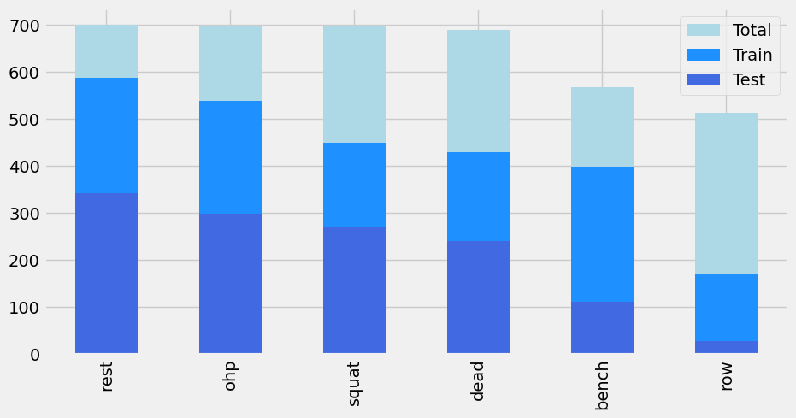
Model Training
Random forest classifier with 5-fold cross validation
Dataset is split into two:
Data just for participant A
Data for everything except participant A
The model is trained on the data without participant A: feature_set_4 as this is the feature set with highest accuracy
It is then tested on the data of participant A which it has never seen
Accuracy of the trained model is 99.53%

Slide 15
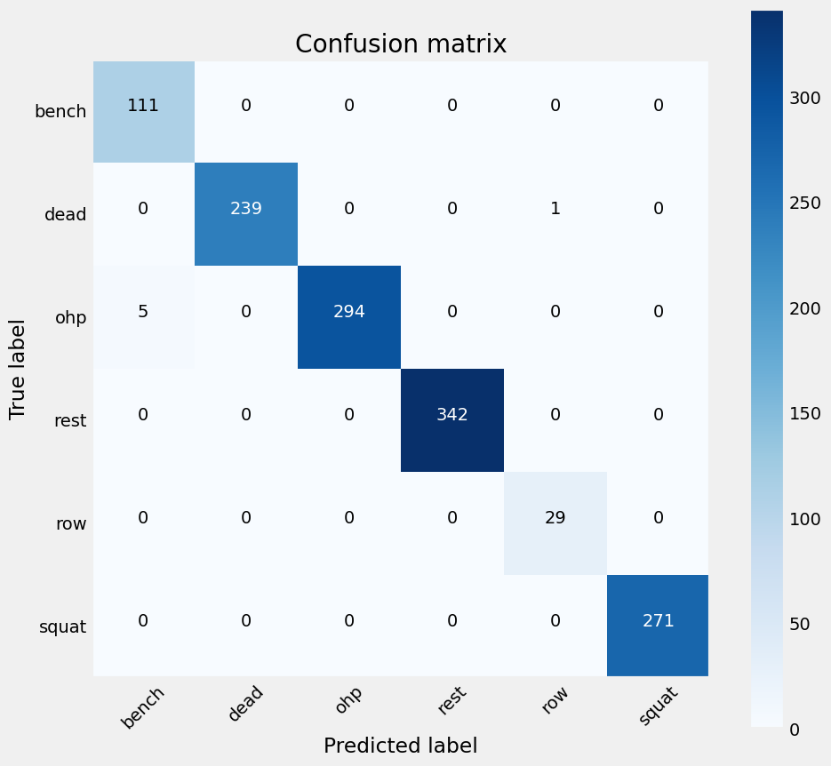
Confusion Matrix
For trained and tested Random forest classifier model

Slide 16
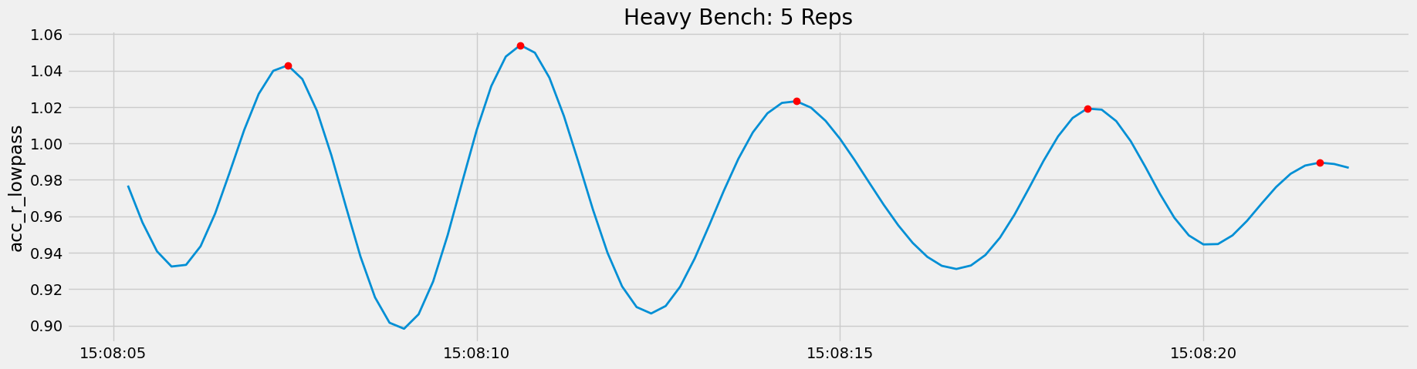
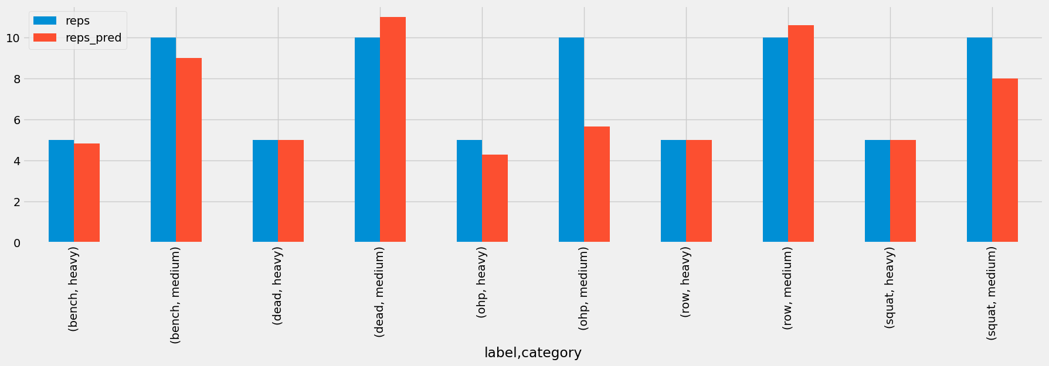
Repetition Counting
Counting reps in a set
Lowpass filter
Counting reps
Calculating scalar magnitudes of the data
Configuring the low pass filter to smooth out datapoints and remove noise from the dataset
Using argrelextrema from scipy.signal library to get indexes of peaks from the new data

Slide 17



Backend
Interface
Frontend
Flask app development for calling python scripts to process and predict input files
User friendly web application development for both input and result pages
UI development for clearer and enhanced user experience
Demo

Slide 18
Future Scope
More Data
Logging database
Larger dataset with diverse metrics can improve model’s accuracy
Storing past exercise routines to be referred again in the future
Expanding Predictions
Personalized recommendations
Incorporating wider variety of exercises for the model to handle
Providing real time personalized recommendations for form improvement
Phone Tracking
Reinforcement training
Real time exercise monitoring and feedback
Adaptive workout plans based on user feedback

Slide 19
Thank you!

